Slide 1
ownCloud Community Edition -- Overview
John Smith
Notes:
Welcome!

Slide 2

About Me
John Smith, Community Enthusiast by night; candy maker by day
Notes:
About me...

Slide 3
About ownCloud
File sync and share
Open Source
Easy to use
Easy to install
Easy to extend
>2 million users!
Notes:
OwnCloud is a file sync and share technology. You run ownCloud on your own server or pick one of the 30+ ownCloud providers.
Both server and clients are open source and are developed with the goals of being easy to install, use and extend.
ownCloud has over 2 million users, making it by far the most popular open source file sync and share technology.

Slide 4
ownCloud Open Source Momentum
Total of 57,000 commits by 550 contributors, 1,500 commits per month
More than just File Sync and Share
  Powerful application and integration platform
  7-10 apps are updated or released per week
  top 10 apps have between 11,000-26,000 downloads
Notes:
Aside from having many users, ownCloud also has a large development community.
In part that is because ownCloud is more than sync and share. Our apps bring functionality like calendar and contacts, mail, notes and much more to ownCloud.

Slide 5
ownCloud -- For end users
Notes:
Let's talk about what ownCloud has to offer for end users.

Slide 6
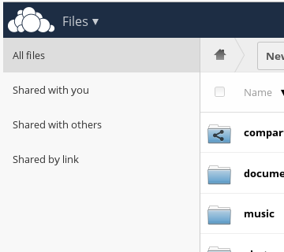
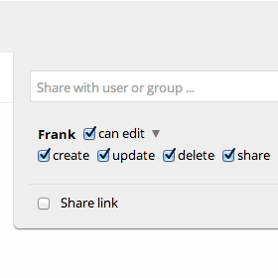
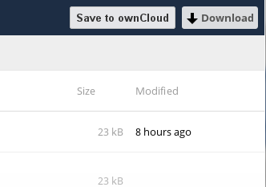
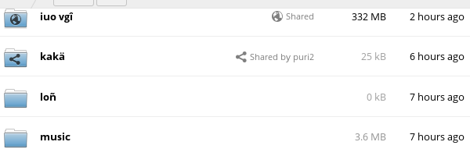
Sharing
Notes:
Sharing is an important aspect of ownCloud. ownCloud shows you who shared what with whom and how and lets you set precise permissions, expiration dates and passwords on shares, both for sharing links and for shares with other users on your ownCloud.

Slide 7
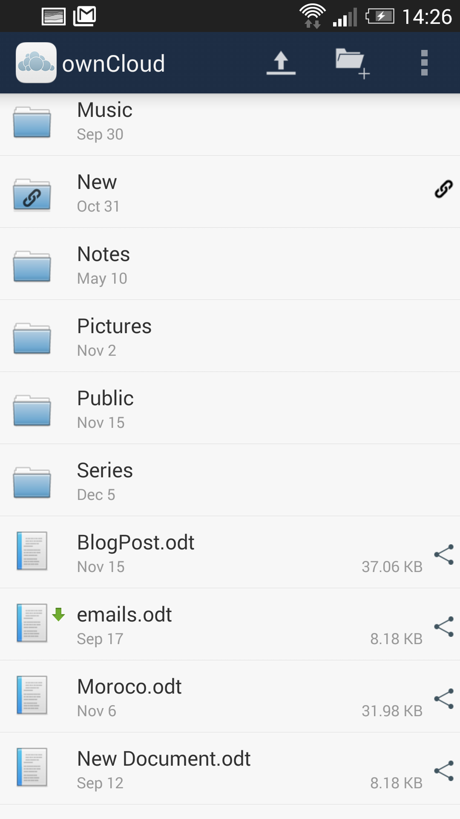
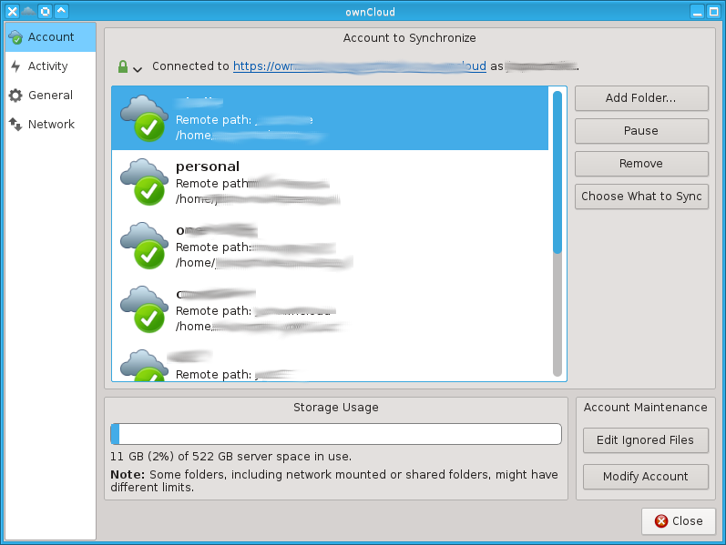
Syncing apps
Notes:
ownCloud offers sync apps for Windows, Mac and Linux as well as Android and iOS. Third party apps exist for Windows Mobile and Sailfish and there are loads of external apps with ownCloud integration thanks to our open source android and iOS integration libraries.

Slide 8
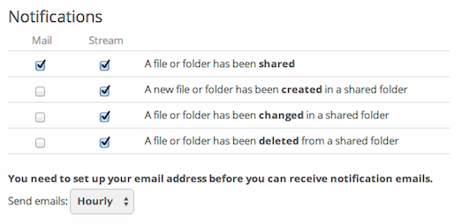
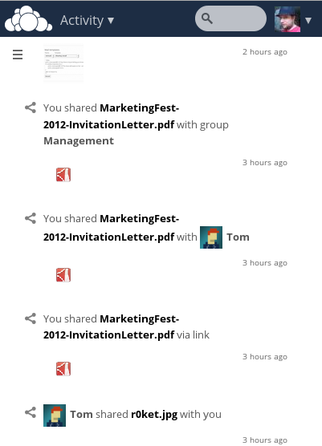
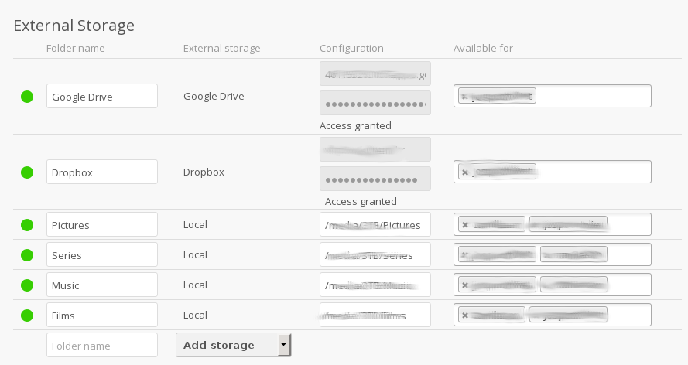
Features
Notes:
Let me mention some other ownCloud features.
ownCloud seamless integrates external storage and with the Encryption app you can encrypt the data on external storage!
The Activity app shows what happened in your ownCloud and sends you notifications.

Slide 9
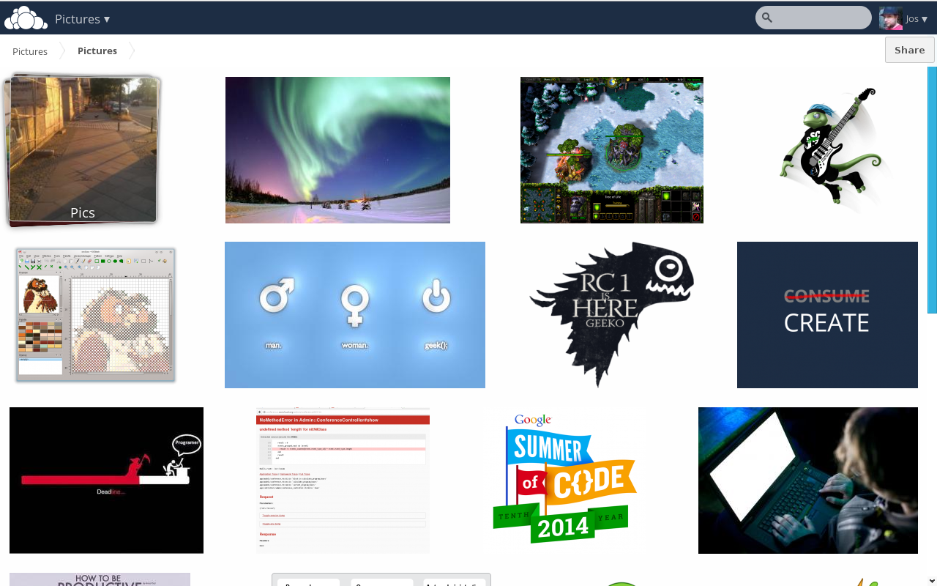
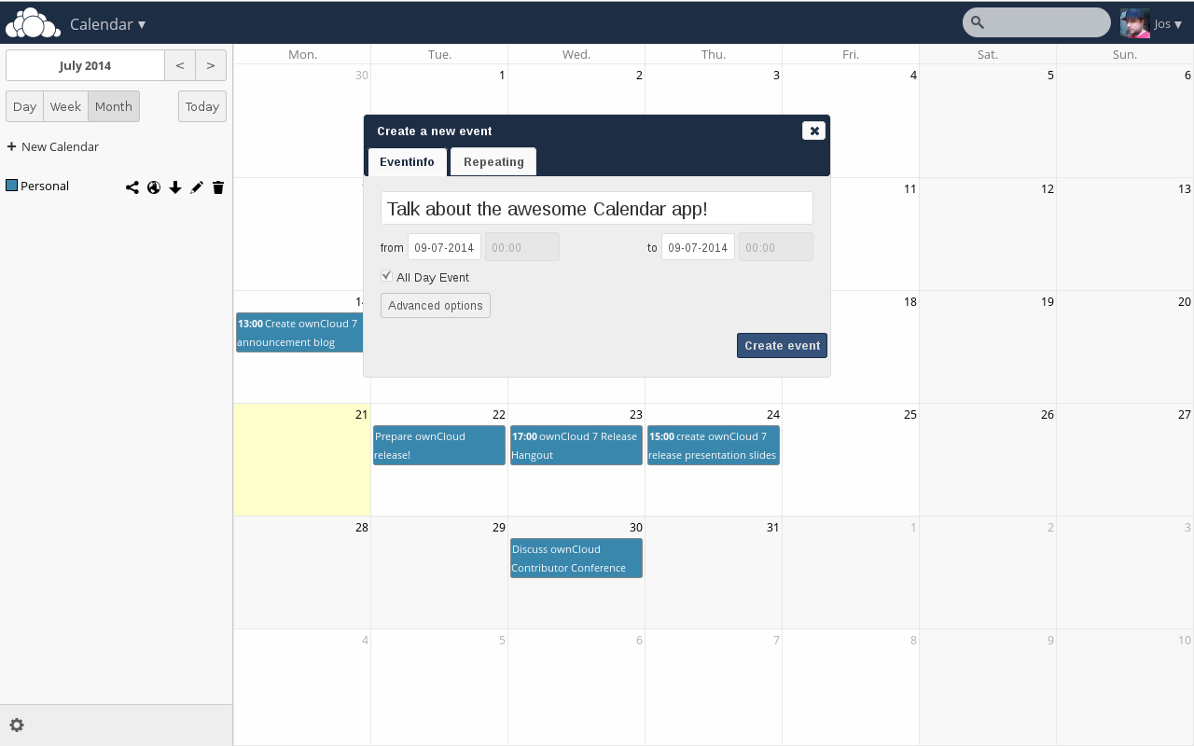
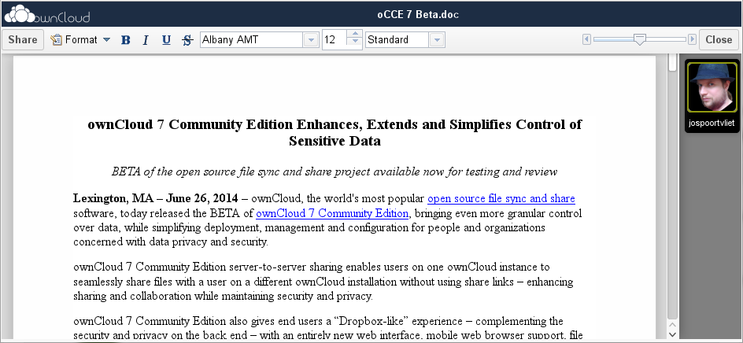
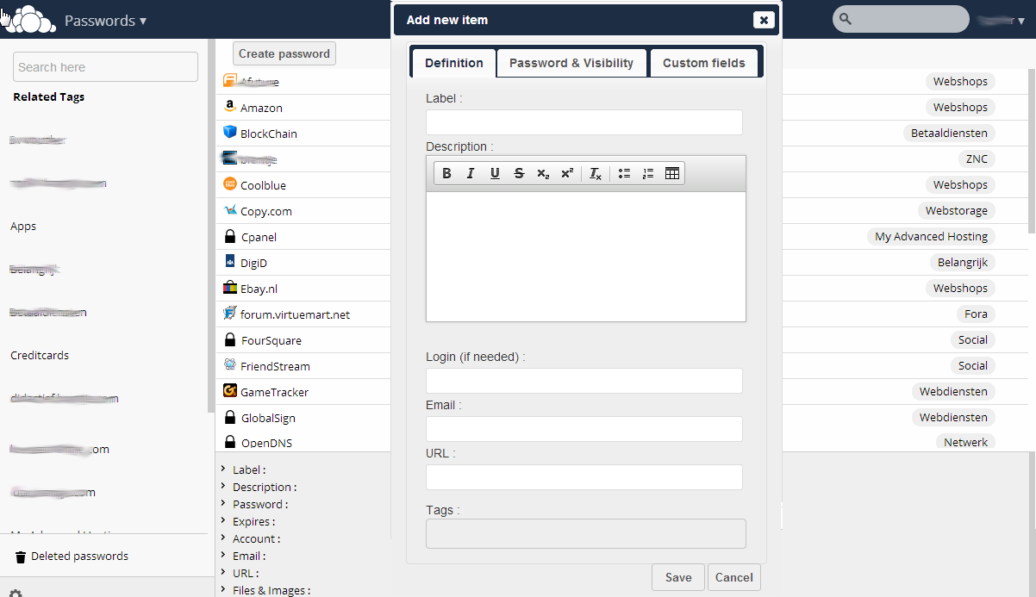
More apps
Notes:
Last but not least, there are the ownCloud apps, like Gallery, Documents (with collaborative editing!), calendar and contacts and many others like a password manager, mail, bookmarks and so on.

Slide 10
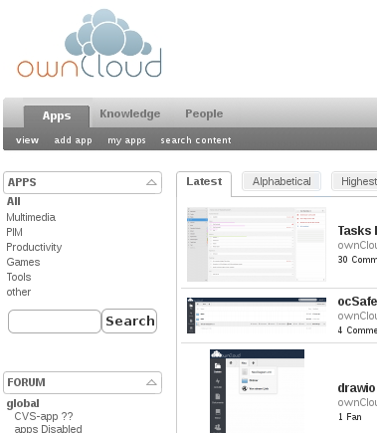
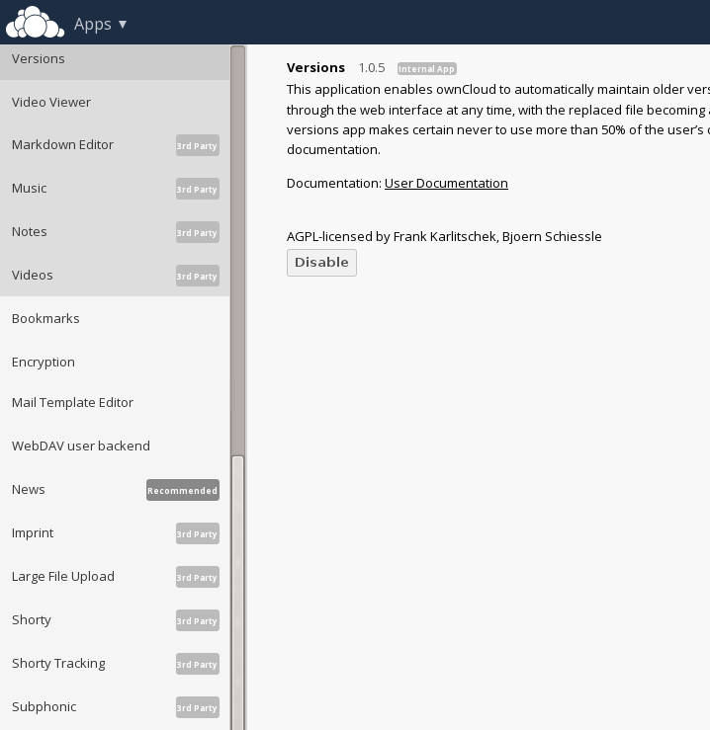
App management
Notes:
Apps can be installed from the ownCloud App manager or from the ownCloud app store, which features over 200 ownCloud apps!

Slide 11
ownCloud--For administrators
Notes:
ownCloud is easy to maintain, but gives a lot of control to system administrators.

Slide 12
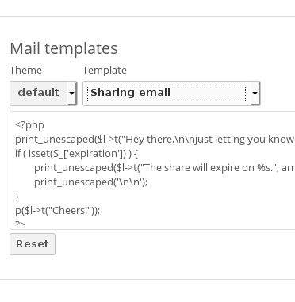
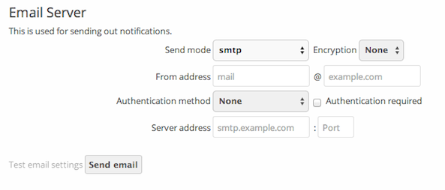

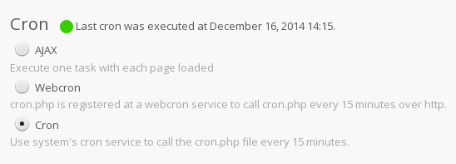

Management
Notes:
ownCloud makes it easy to manage your installation. It warns you about security issues and other problems, lets you fine-tune what your users can and can't do and all that in an easy user interface.

Slide 13
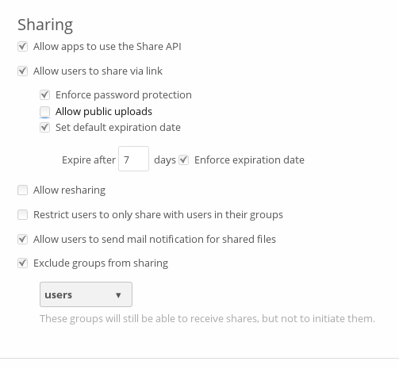
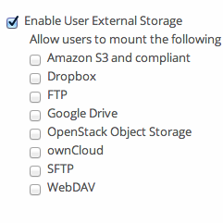
Control Sharing
Notes:
You can control sharing and the use of external storage to protect your users' data

Slide 14
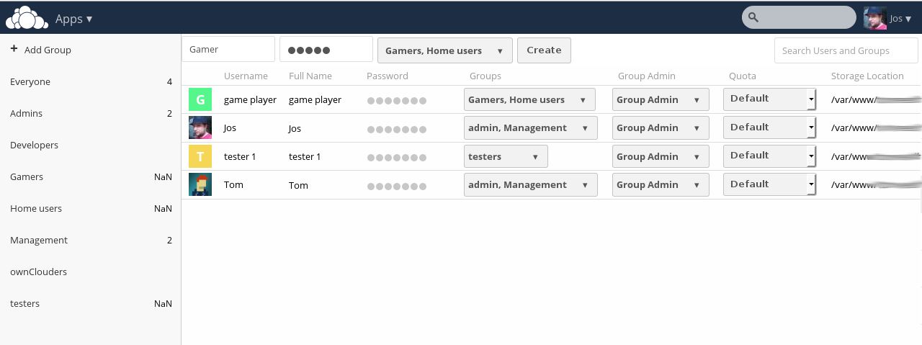
User management
Notes:
And of course manage the users themselves, with groups and permissions.

Slide 15
ownCloud -- For developers
Notes:
ownCloud is always looking for developers. We offer easy API's to develop apps with and of course welcome contributions to the existing apps and core of ownCloud.

Slide 16
App developers
API inspired on Rails and Symfony
Generator for base app with dependency injection, routing, database layer, middleware and controllers
doc.owncloud.org & #owncloud-dev
Third party developers
Pub/sub model Webhooks
API for sharing, list, up/download etc

Slide 17
Links
Get it on owncloud.org/download
Try it on demo.owncloud.org
Join on owncloud.org/contribute
Find help on doc.owncloud.org
For large scale use see ownCloud.com

Slide 18
OwnCloud -- Questions?

